Slide 1
Sample Management

Slide 2
Table of contents
We will talk about this
Lot Catalog
My Samples
Sample Transactions
Product Catalog
Sample Lots

Slide 3
Table of contents
We will talk about this
State License Management
Sample Audit Administration
Sample Limits
Sample Inventories

Slide 4
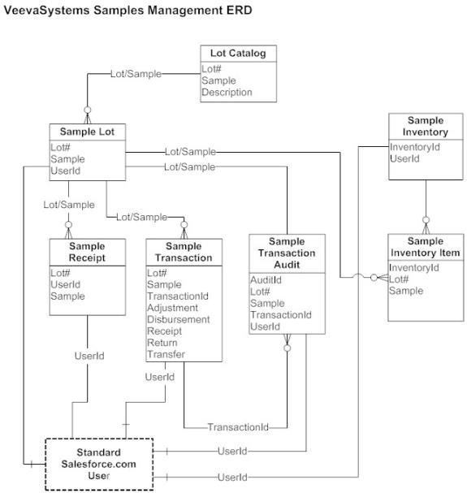
Sample Management Data Model

Slide 5
Sample Transactions
Stores all of the various types of Sample Transactions performed through calls and other ways.
No permissions to end users to edit on these transactions to avoid tampering of data and misuse.
Types of Sample Transactions
Types | Purpose
Adjustment_vod | Provides the ability to report lost or stolen Samples
Return_vod | Provides the ability to report return destroyed or expired Samples
Disbursement_vod | Provides a read-only view of a Sample Disbursement to an Account like in Calls
Receipt_vod | Provides the ability to receive Samples either from another user or from a fulfillment center.
Transfer_vod | Provides the ability to transfer Samples to another user like District Manager.

Slide 6
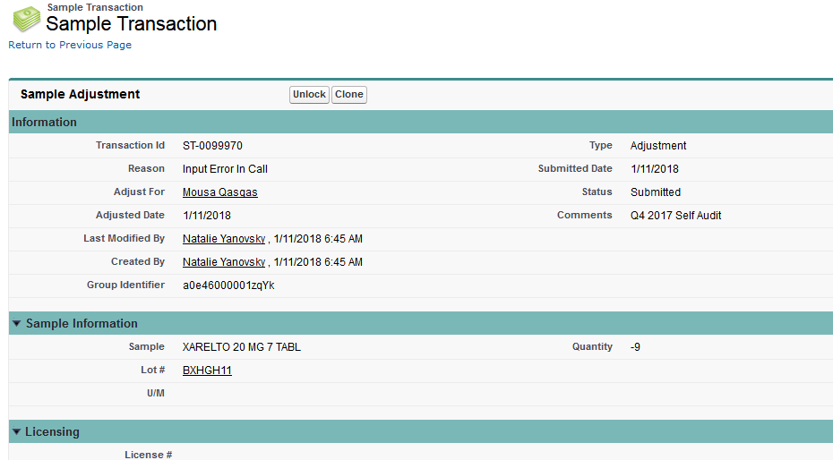
Adjustment Sample Transaction
Adjustment :
User’s needs to adjust the Calculated Quantity of a Sample Lot.
Usually when Sample Lot has been lost or stolen
The list of available Reasons for an Adjustment Sample Transaction can be controlled by modifying the picklist values for the Reason field on Sample Transaction.

Slide 7
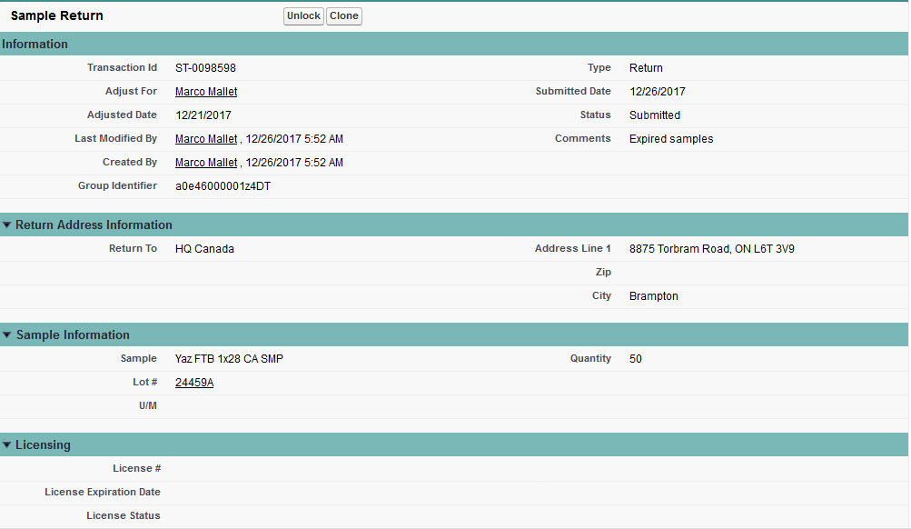
Return Sample Transaction
Return :
To create transactions for return of samples that are expired or destroyed during shipment
Mandatory to populate Return To picklist with address the samples should be returned to
Possible locations like HQ, Distribution Centers and/or any 3rd party managing the organization’s Samples
Return addresses are auto-populated on Return transactions to increase successful returns
Return addresses are stored in the Rep Roster

Slide 8
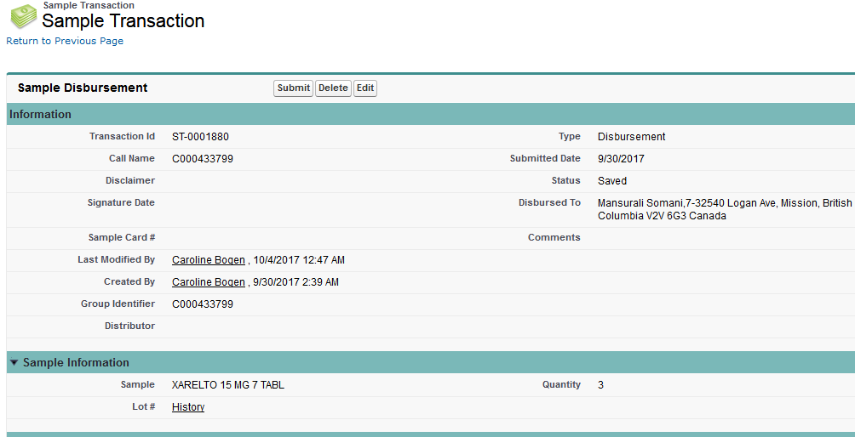
Disbursement Sample Transaction
Pertaining to a Sample Drop as part of a Call Report
Access to the Disbursement Record Type should not be given to users as this allows a user to create a Disbursement Sample Transaction that is not based on a Call
These transactions support both paper-based Sampling as well as Electronic Signature Sampling

Slide 9
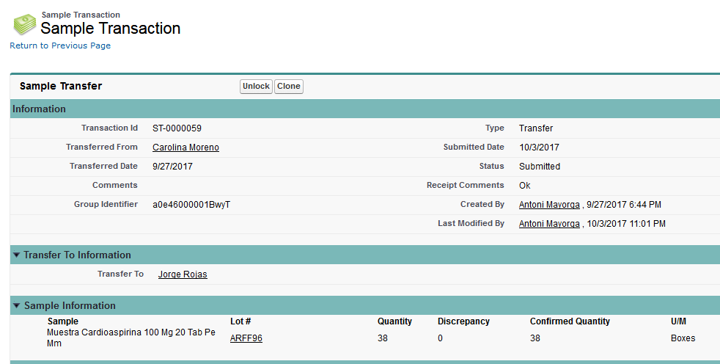
Transfer Sample Transaction
User’s need to transfer a quantity of a Sample Lot to another user
District Managers have access to all reporting Sales Reps and can perform Transfer Sample Transactions accordingly
BPH_Backoffice Users can do same as the managers

Slide 10
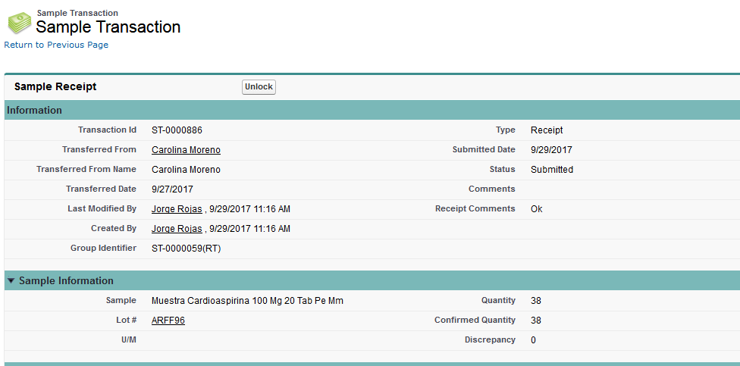
Receipt Sample Transaction
User’s acknowledgement of from a Transfer or a Sample Receipt record that was created as part of a 3rd Party or Back-office integration

Slide 11
Receipt Sample Transaction Contd
Confirmation of a Sample Receipt record performs the following actions:
Creates a Receipt Sample Transaction for the User
Updates the related Transfer Sample Transaction with the following fields:
Received Check box
Receipt Comments
Ref Transaction Id [Receipt Sample Transaction Id]
Confirmed Quantity
Users need Create/Update/Read permission to the Sample_Receipt_vod object to confirm receipt of Sample and to send a Sample Receipt.

Slide 12
My Samples for the User

Slide 13
Sample Limits
Restrict number of sample quantities being disbursed
Limits can be enforced at the following levels:
Account
User
Account-User
Per Call
A sample limit can be defined at different levels for a given product:
Account Limit
For an Account, X sample quantity can be disbursed over a period of time
Applies to a specific Account across all Users
User Limit
A User can disburse X sample quantity over a period of time
Applies to a specific user across all Accounts
Account-User Limit
For an Account for a user, X sample quantity can be disbursed over a period of time
Applies to a specific user for a specific Account
Limit per Call

Slide 14
Sample Inventories
Provides the ability for a user to create a physical inventory count of all the Sample Lots that are currently marked as Active
Only Sample Inventory records that are of a Status of Saved can be edited
Sample Inventory types
Monthly
Quarterly
Year-end
Close-Out
Annual
Inventory is usually done by the District or Sales Manager
Other Users can also do the same if access like role hierarchy and data sharing rules are defined accordingly
Sample Inventory Worksheets can be printed by generating a PDF version of the page
Enable the ENABLE_INVENTORY_WORKSHEET Veeva Setting to use this functionality
This displays a link on the Sample Inventories section of the My Samples page
The text of the link can be changed by modifying the PRINT_INVENTORY Veeva Message

Slide 15
